Slide 1

N4 RECOVERY TEAM
WEEK 4

Slide 2
OBJECTIVES
Design of Control Circuit of FSM
Modification of Avionics Bay
Procurement of Components
Modification of Spring Ejection Mechanism
Creation of State Machine conditions Flowchart
Implementing state machine conditions on code
Improvement on payload code

Slide 3
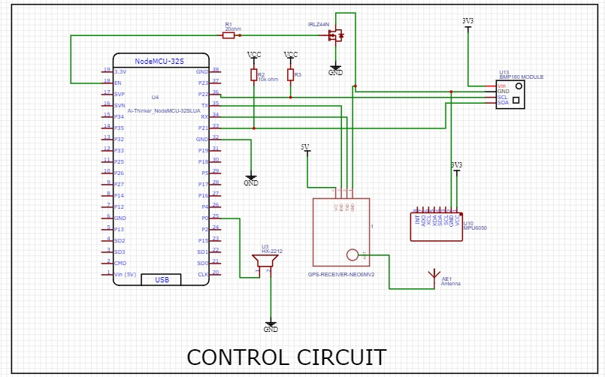
Design Of Control Circuit

Slide 4
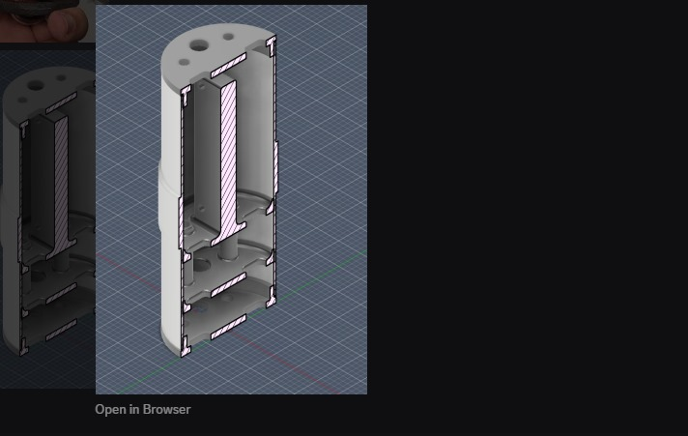
Redesign of Avionics Bay

Slide 5
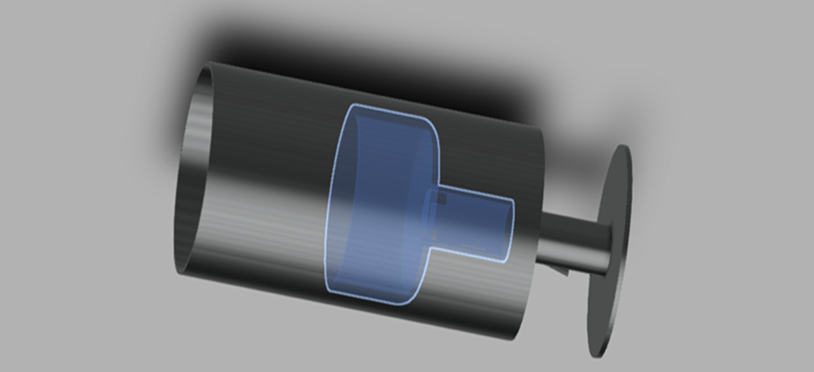
Modification of spring mechanism

Slide 6
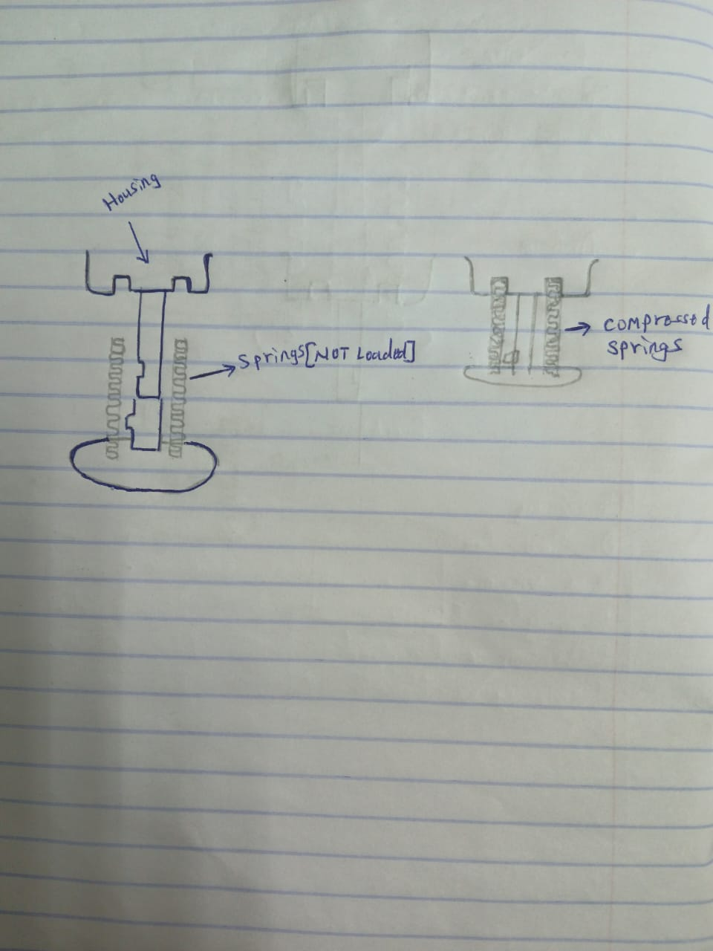

Slide 7
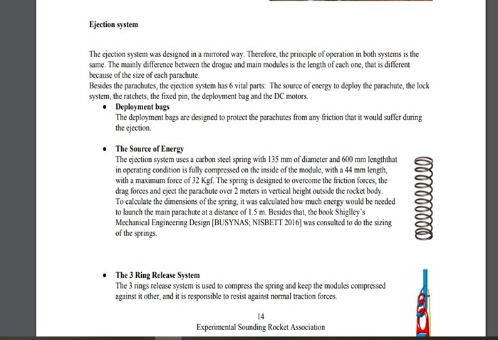
Universidade de Sao Paulo

Slide 8
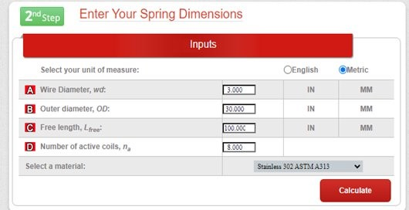
Springs design Calculation
https://www.planetspring.com/pages/compression-spring-calculator-coil-calculator.php

Slide 9
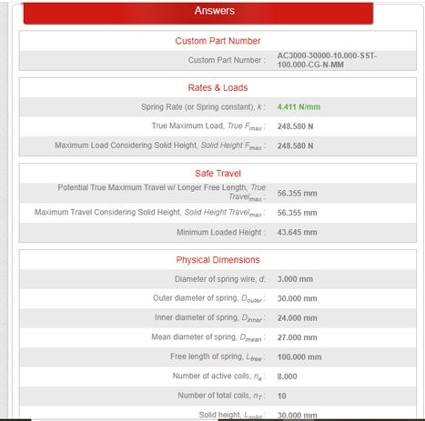

Slide 10
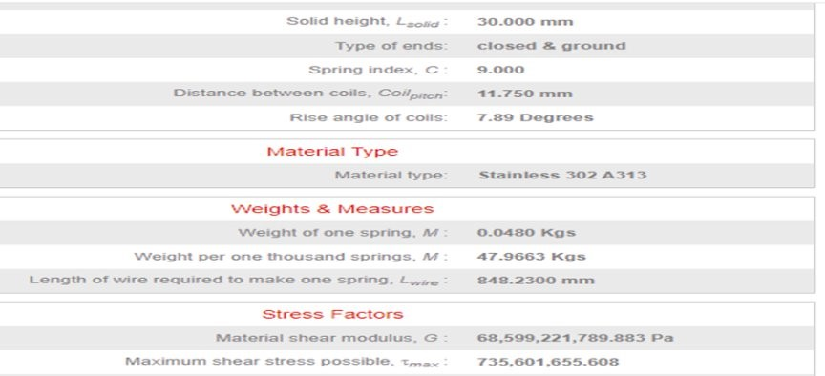

Slide 11
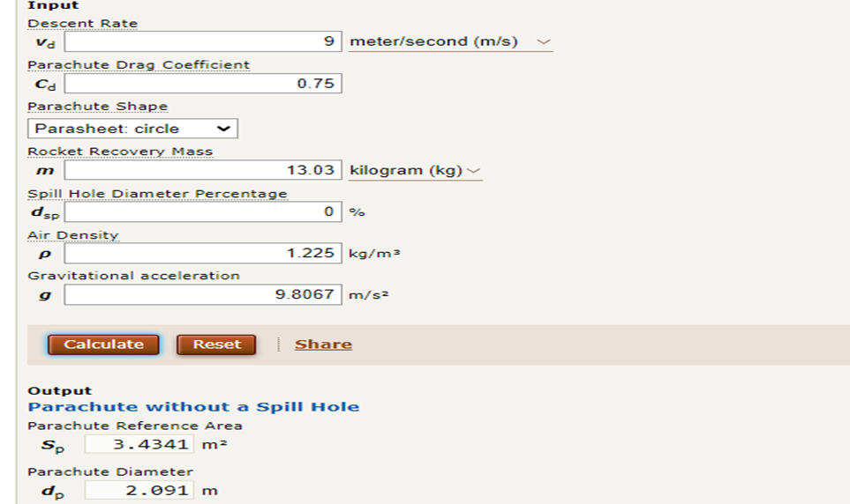
Parachute Design
https://www.translatorscafe.com/unit-converter/en-US/calculator/parachute-size/

Slide 12
Pyrotechnic
Black powder is mostly used in the ejection mechanisms
Electric igniter ignites the black powder which pressurizes the parachute bay above the atmospheric pressure and this breaks the shear screws and the parachutes are deployed.

Slide 13
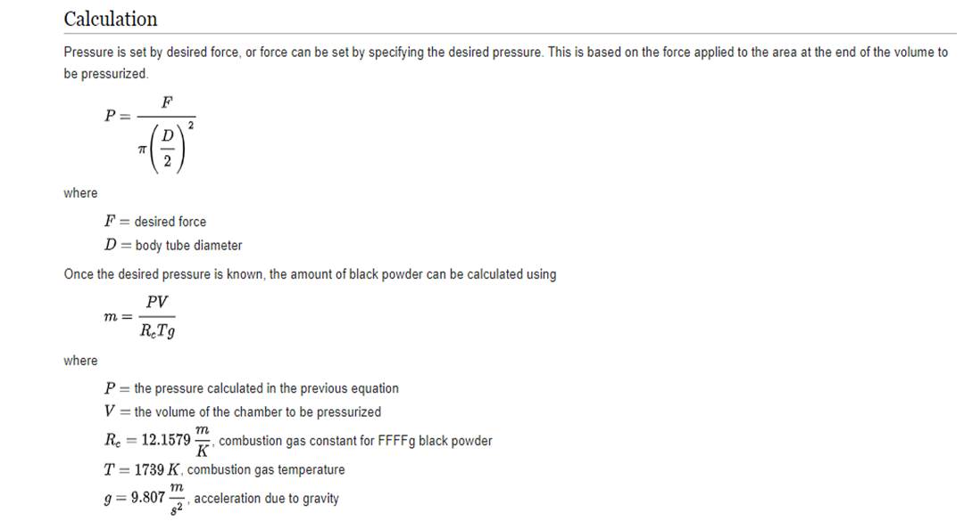

Slide 14
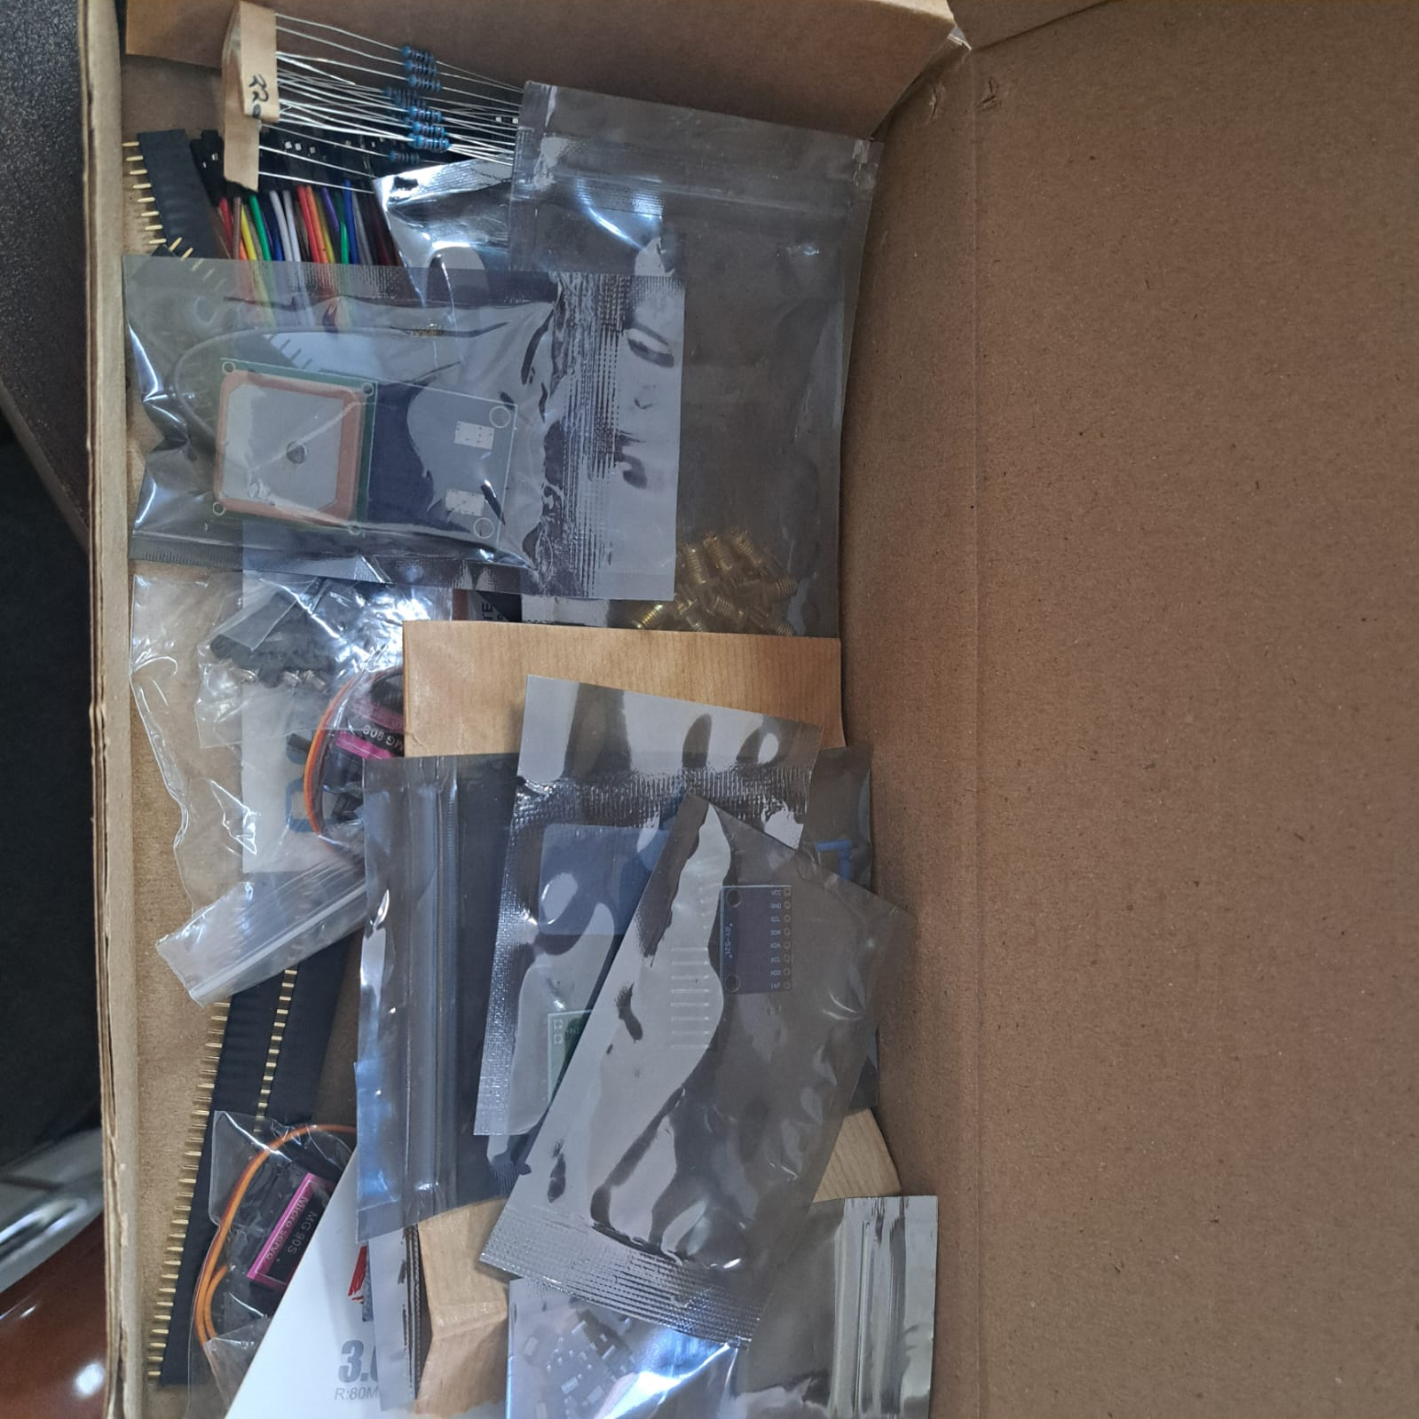
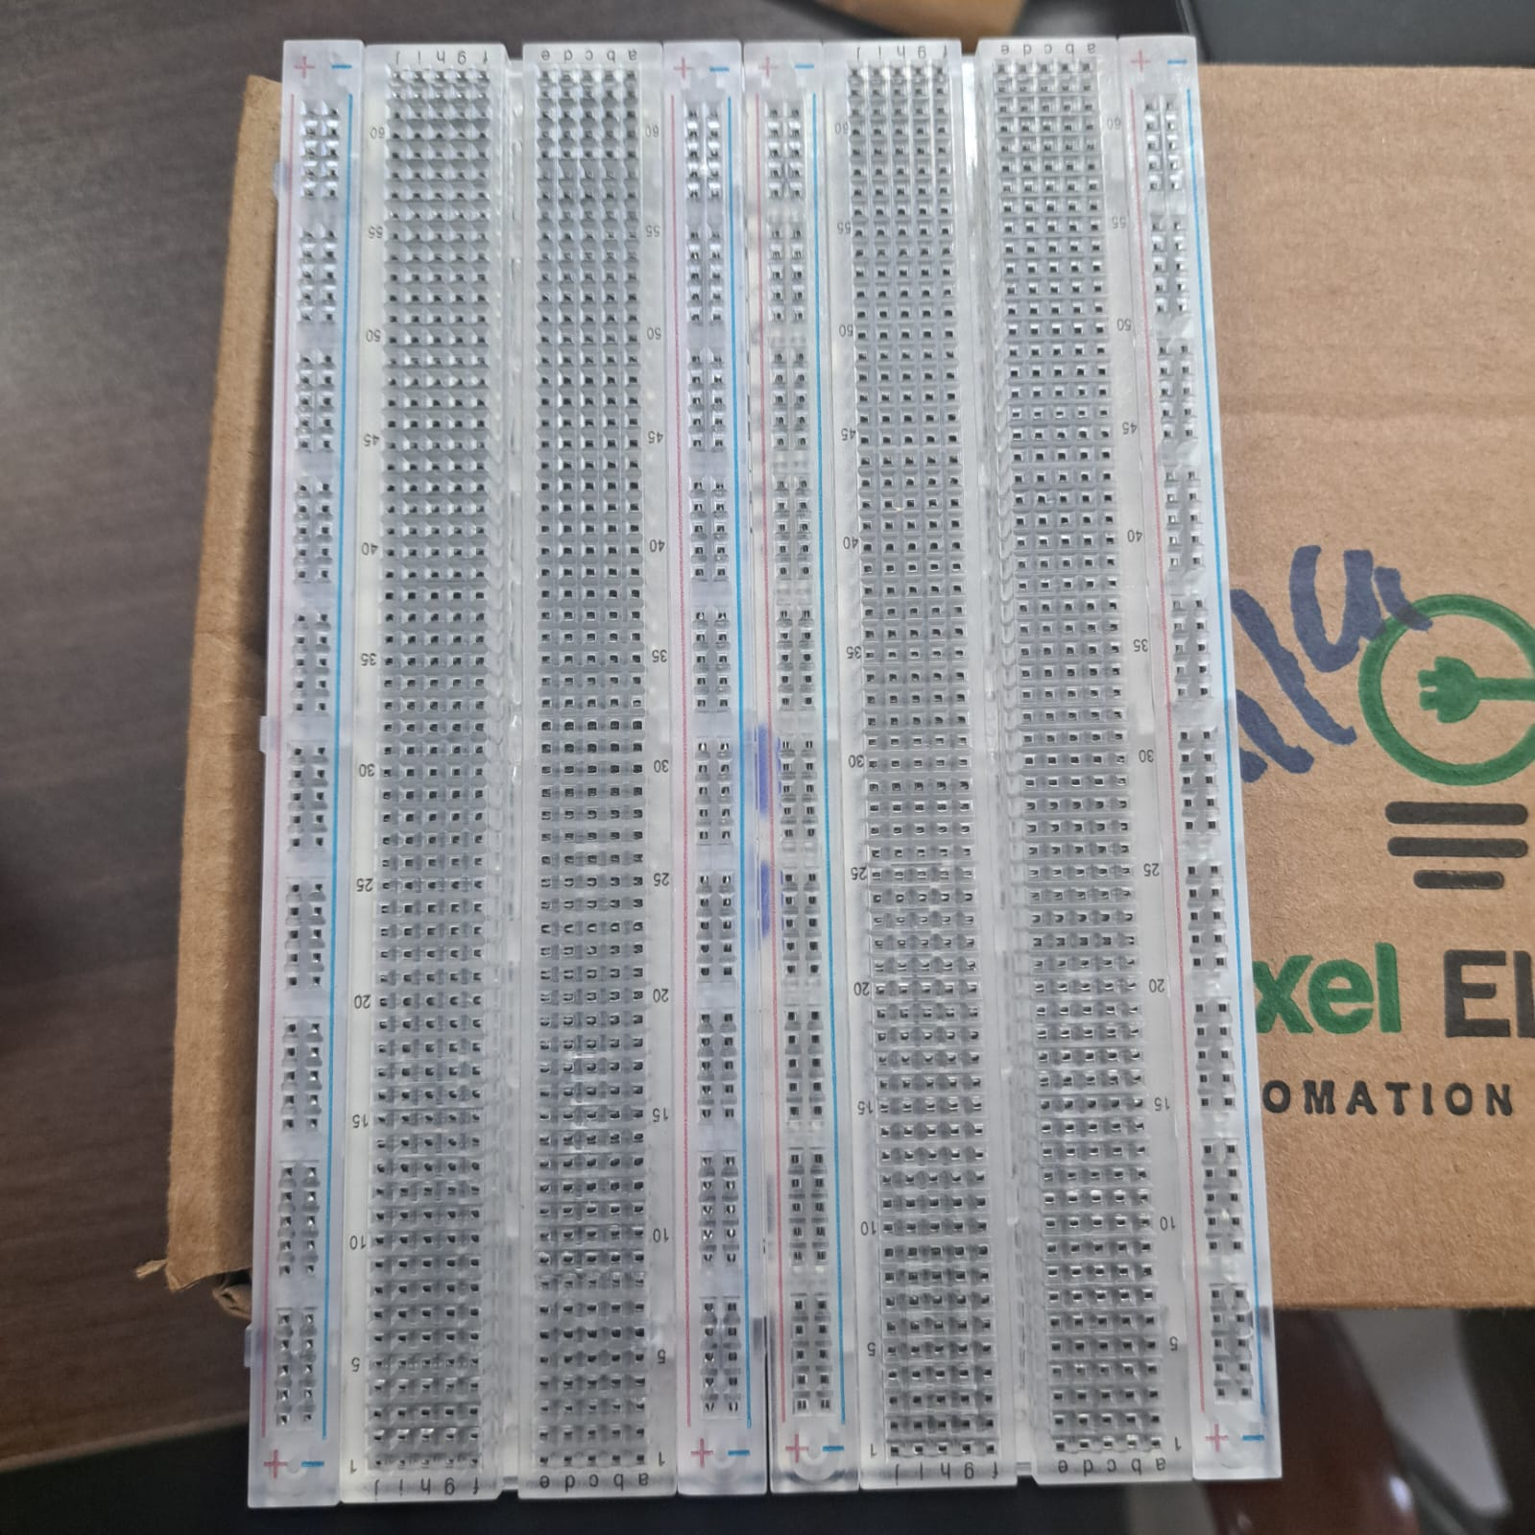
Procurement of components

Slide 15
Creation Of State Machine Conditions Flowchart
Link to flowchart: Checkstate Flowchart.docx

Slide 16
THANK YOU

